Slide 1
COLLEGE 101
INSTRUCTOR: LISA MEIGHAN
WEEK 9

Slide 2
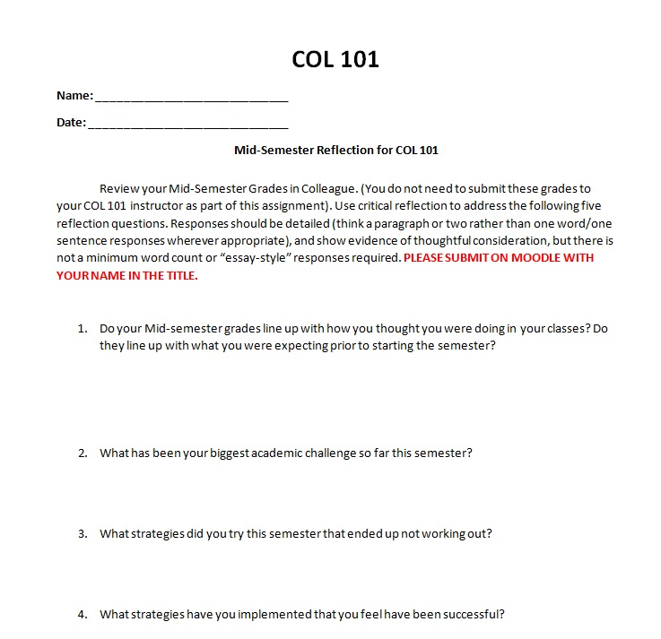
WEEK 8 – HOMEWORK
DUE TODAY (WEEK 9) , WORTH 5 POINTS:
MIDTERM REFLECTION -

Slide 3
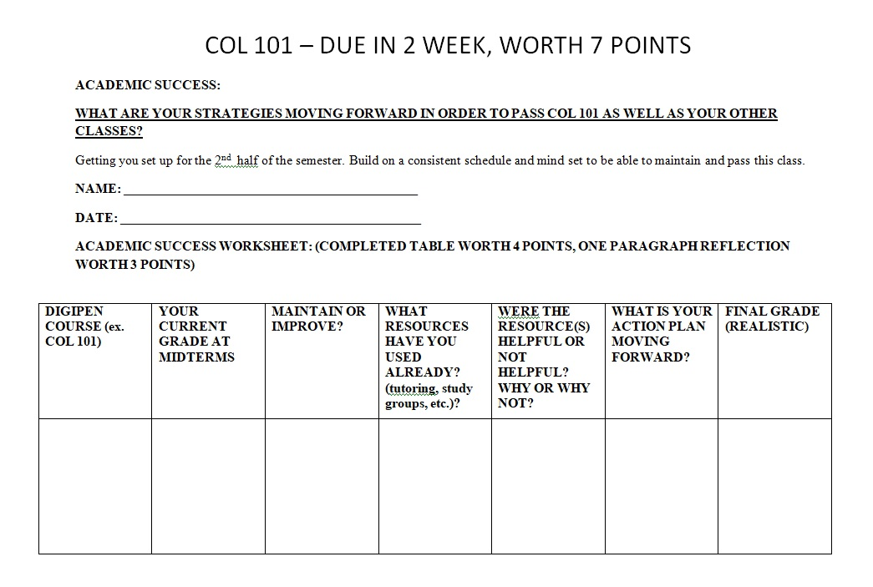
WEEK 8 HOMEWORK
DUE NEXT WEEK (WEEK 10): WORTH 7 POINTS:
ACADEMIC SUCCESS ASSIGNMENT,
COMPLETED TABLE WORTH 4 POINTS
AT LEAST ONE PARAGRAPH REFLECTION WORTH 3 POINTS

Slide 4
WEEK 9 – BUILDING HEALTHY RELATIONSHIPS
TITLE IX AND WHY IT MATTERS:
As a part of the New Student Orientation Module, you received a link to complete an online Title IX Training Module. This is required to be completed by all new students, and we record each student’s completion of the module in COL 101. Please complete the Title IX module at this link:
https://www.studentlingo.com/digipen) and upload the certificate.
-Federal law that aims to make access to education equal for all students, regardless of gender
-Includes access to resources, access to schools, and protection from discriminatory behavior.
-It is a mandate for all educational institutions.
-Separate from a Criminal Report (Police)

Slide 5
WEEK 9 – BUILDING HEALTHY RELATIONSHIPS
TITLE IX:
(from the studentlingo.com website)
VIDEO: WHAT IS SEXUAL VIOLENCE AND STALKING (+/- 5 min)
VIDEO: RESPONDING TO SEXUAL VIOLENCE (+/- 3 min)
VIDEO: PROMOTE HEALTHY RELATIONSHIPS (+/- 3 min)

Slide 6

WEEK 9 – BUILDING HEALTHY RELATIONSHIPS
TITLE IX AND DIGIPEN’S STATEMENT OF POLICY:
-Digipen is committed to maintaining a positive emotional and physical environment in which all students have an equal opportunity to achieve success.
-Digipen will not tolerate any acts of harassment or non-consensual sexual activity.
-Intimidation, harassment, and sexual misconduct violate the standards of acceptable behavior and academic freedom of all students on campus and in the Digipen community.

Slide 7
WEEK 9 – BUILDING HEALTHY RELATIONSHIPS
TITLE IX AND DIGIPEN’S STATEMENT OF POLICY:
ANTI-HARASSMENT POLICY;
DigiPen prohibits harassment of any kind between faculty/staff and students, between students and students, between faculty/staff/students and others, on the basis of race, sex, gender, gender identity, gender expression, color, national origin, ancestry, religion, physical or mental disability, veteran status, age or any other basis protected by federal, state, or local law.​
ANTI-DISCRIMINATION POLICY;
Digipen does not discriminate in its educational and employment policies on the basis of race, color, creed, religion, national/ethnic origin, sex, gender, gender identity, gender expression, sexual orientation, age, or with regard to the basis outlined in the Veterans’ Readjustment Act and the Americans with Disabilities Act.​

Slide 8
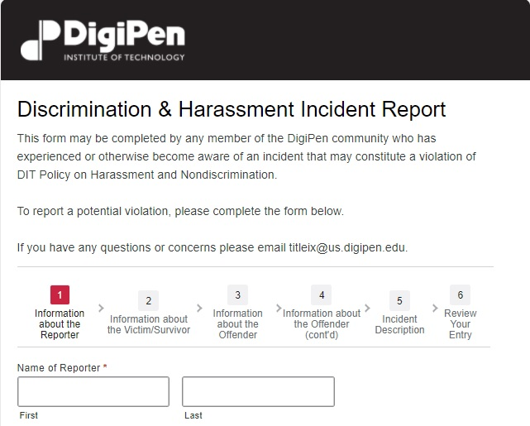
WEEK 9 – BUILDING HEALTHY RELATIONSHIPS
DIGIPEN’S RESOURCES:
CONFIDENTIAL RESOURCES
DigiPen Counseling Staff
NON-CONFIDENTIAL RESOURCES
-Title IX Coordinators, All Digipen
Faculty and Staff,
Student Staff in Work-Related Positions
-If you report directly to a Title IX Coordinator,
you will need to complete the online
Discrimination & Harassment
Incident Report Form. ​
-For more information, the link is:
digipen.edu/title-ix​

Slide 9

WEEK 9 – BUILDING HEALTHY RELATIONSHIPS
TITLE IX AND HOW DIGIPEN DEFINES CONSENT
Consent is a voluntary agreement to
engage in sexual activity; someone
who is incapacitated cannot consent;
past consent does not imply future consent;
silence or an absence of resistance
does not imply consent; consent to
engage in sexual activity with one person
does not imply consent to engage
in sexual activity with another.​

Slide 10
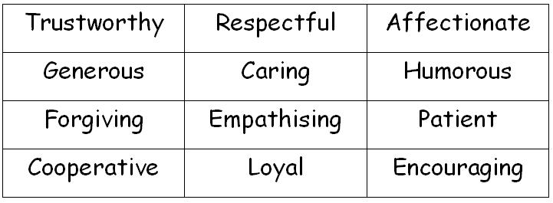
WEEK 9 – BUILDING HEALTHY RELATIONSHIPS
VIDEO; BUILDING HEALTHY RELATIONSHIPS (+/- 5 min)
VIDEO; HEALTHY BOUNDARIES IN RELATIONSHIPS (+/- 2 min)
RELATIONSHIPS: WHY ARE GOOD RELATIONSHIPS BENEFICIAL?
IN SMALLER GROUPS:
-What are some characteristics of your friends that help your friendship?
-What characteristics do you bring to a peer relationship?
-What are some characteristics you are NOT looking for in a peer relationship?

Slide 11
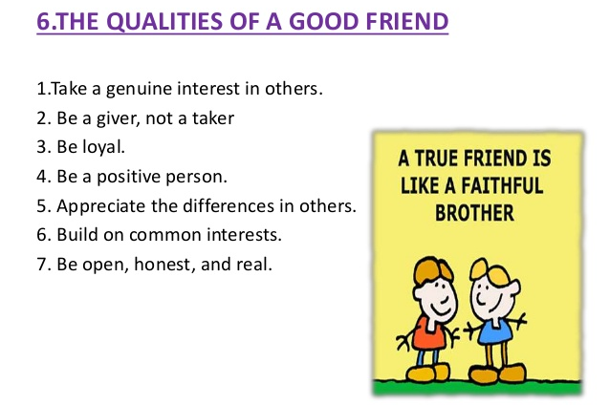
WEEK 9 – BUILDING HEALTHY RELATIONSHIPS
TIPS TO HELP YOU DEVELOP MORE POSITIVE AND HEALTHY RELATIONSHIPS IN ALL AREAS OF YOUR LIFE:
Accept and celebrate differences.
Listen effectively.
Give people your time.
Develop your communication skills.
Manage mobile technology (being on
your phone while with another person).
Learn to give and take feedback.
Learn to trust more.
- Develop empathy.

Slide 12
WEEK 9 – BUILDING HEALTHY RELATIONSHIPS
MATTERING AND MARGINALITY (Nancy Schlossberg)
VIDEO: MATTERING VS MARGINALITY (+/- 1 MIN)
MARGINALITY:
A sense of not fitting in which can lead to self consciousness, irritability and depression. ​
Feelings of marginality often occur when individuals take on a new role or join a new​
group​.
MATTERING:
Feeling that one belongs and matters to others. When present, mattering diminishes marginality and promotes a healthy and successful transition.
Five Aspects:​
1. Attention: Feeling that your are noticed​
2. Importance: Belief that you are cared about​
3. Ego Extension: Feeling that someone will be proud of your accomplishments and sympathize with your failures​
4. Dependence: Feeling of feeling needed​
5. Appreciation: Feeling that ones efforts are appreciated by others​
​

Slide 13
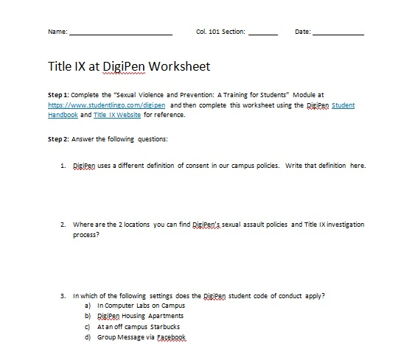
WEEK 9 – HOMEWORK
TITLE IX WORKSHEET, 1 WEEK ASSIGNMENT (WORTH 10 POINTS):
Complete the “Sexual Violence and Prevention: A Training for Students” Module at https://www.studentlingo.com/digipen
and then complete this worksheet using the DigiPen Student Handbook (digipen.edu/sites/default/files/public/docs/digipen-student-handbook.pdf)
and Title IX Website (digipen.edu/title-ix) for reference.

